Slide 1
Final project
Albert Hinojosa Rovira
22/01/2020

Slide 2
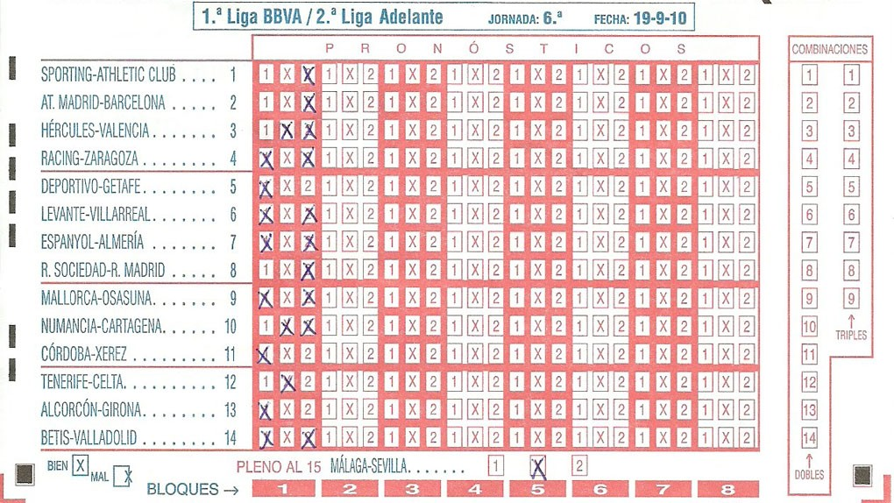

Slide 3
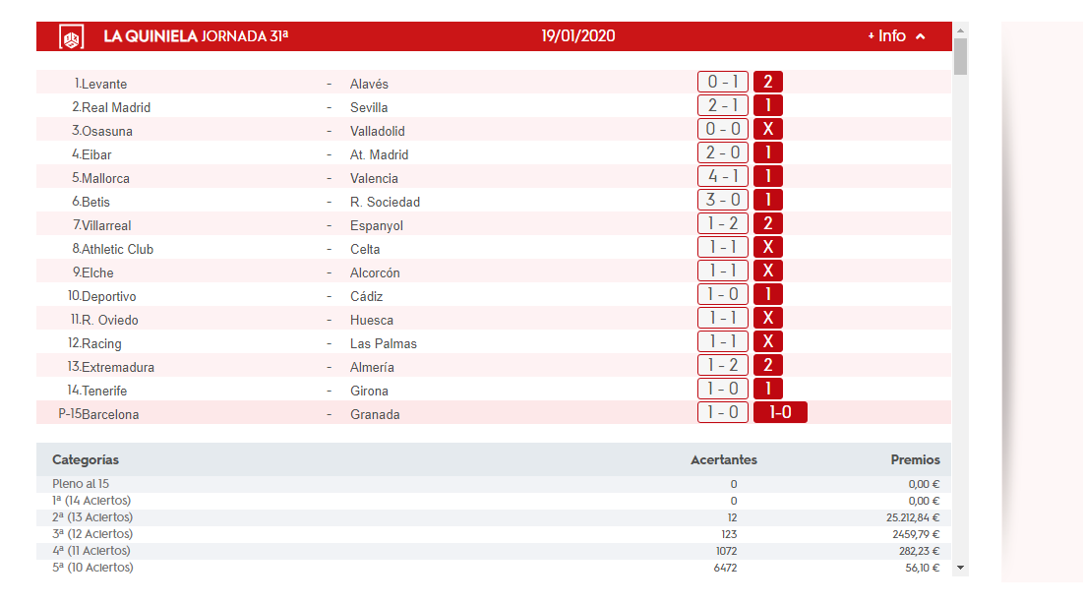

Slide 4





WORK PROCESS
1
2
3
4
5
COLLECT DATA
ANALIZE
ML MODELS
GET PROBABILITIES
GET MONEY

Slide 5

PERSONAL GOAL
✗
Data Analytics project with super cool models
A complete Data Science Project
Make money
Learn
✓
✗
✓

Slide 6
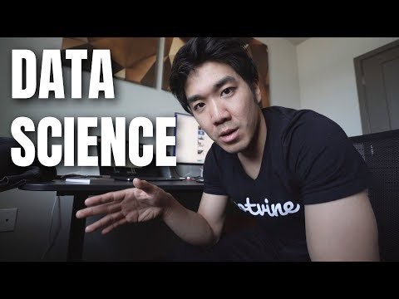
What is data science
Data Science is not about making complicated models, is not about making awesome visualizations, is not about writing code. Data Science is about using data, to create as much impact as possible for your company.
Impact can be in the form of multiple things. It could be in the form of Insights, in the form of data products or in the form of product recommendations for a company.
To do those thigs, then you need tools, like making complicated models, or data visualizations, or writing code. But essentially as a Data Scientist your job is to solve real company problems using data and what kind of tools you use, we don’t care.

Slide 7


Tools and Technologies used
Machine Learning
API
Web Scraping
MongoDB (Atlas)
Dash
PYTHON

Slide 8
WORK PROCESS
1
2
3
4
5
COLLECT DATA
ANALIZE
ML MODELS
GET PROBABILITIES
GET MONEY

Slide 9







THE DATA – sources
Excel file with Historic Data. Results of all the games of 1st and 2nd Spanish League since first edition.
Update of the historical Database with results of current season and future seasons of 1st and 2nd Spanish League.
Web Scraping of current official Quiniela connecting to Loterias y Apuestas webpage

Slide 10
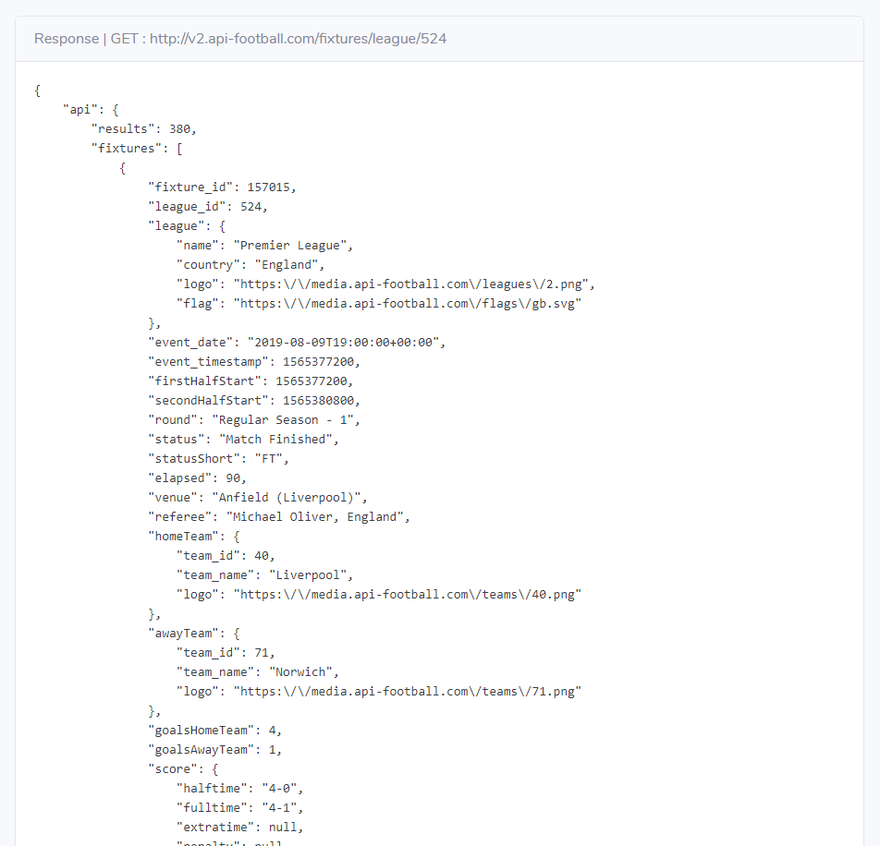
What is an api
API is the acronym for Application Programming Interface, which is a software intermediary that allows two applications to talk to each other.
In this case is the way that Quinielas has to access the data stored in https://www.api-football.com and download it in json format.

Slide 11

The data – structure of data
League (1st or 2nd league)
Round
Date of the game
Home & Away Team
Result & Quiniela Result (1X2)
DATABASE
FINAL FULL DATABASE
Last 2 / 5 / 10 games results for each team (% 1X2)
Head to head historical results in the last 2 / 5 / 10 games
Away team as visitor results
Home team as local results
FEATURE ENGINEERING
To learn something new
If offers 500MB of storage in the cloud for free forever

Slide 12
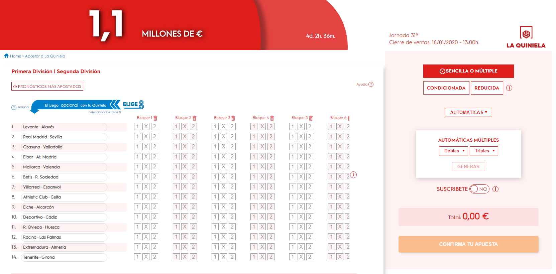
The data – web scraping
https://juegos.loteriasyapuestas.es/jugar/la-quiniela/apuesta/

Slide 13
Used data
1st League Results by Year
20 years

Slide 14
Machine learning models
Random Forest
Gradient Boosting Trees
Xtreme Gradient Boosting (XGB)
Support Vector Machine
KNN
Logistic Regression
Accuracy
Kappa
F1-Score
Distribution of probabilities
% 1
% X
% 2
LOGISTIC REGRESSION

Slide 15
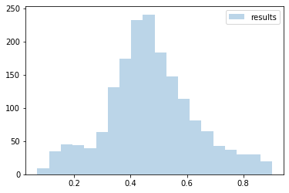
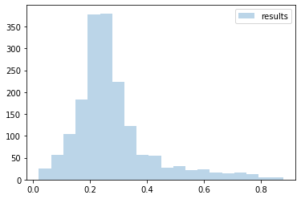
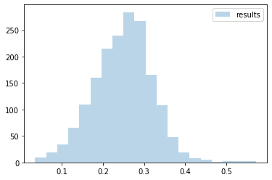
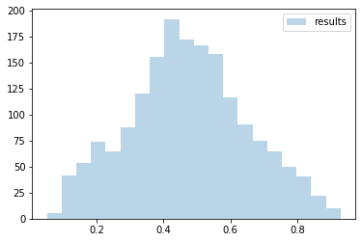
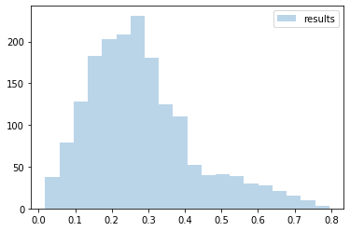
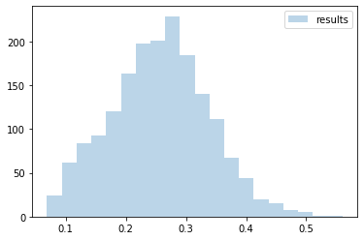
probabilities FOR MODEL SELECTION
1 - PROBABILITIES
2 - PROBABILITIES
X - PROBABILITIES
OTHER
LOGISTIC

Slide 16





Project workflow
2019/2020 and after
Game Results before 2019
Web Scraping from Quinielas official webpage with Beautiful Soup
Probabilities for each game to have 1/X/2
Machine Learning models
Final Predictions
Storing all the information in MongoDB Atlas

Slide 17
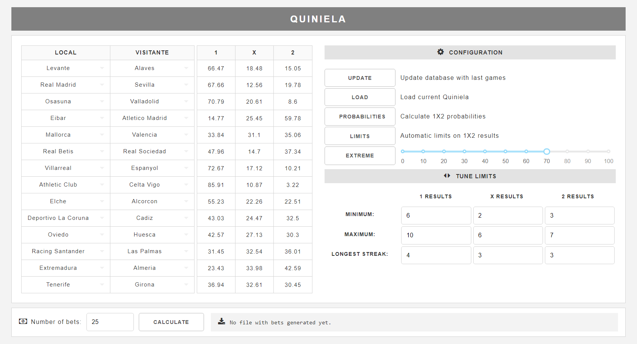

Slide 18
Things to improve
Automatize processes to access to a new season.
Interface to manage dictionaries (New Teams)
Build better models with more information and make better predictions.
Create a module to check bets created in the past.
Don’t stop learning but start making money.
Store the WebApp in a cloud service.

Slide 19
Thank you for your interest

